Slide 1
Мировой поставщик адреналина
Notes:
The leisure outdoor market is expanding world wide. TECHFUN increases the attractiveness of tourist sites by offering its customers the possibility to operate profitable activities.
Thrill leisures are the target of TECHFUN. It promotes ​value autonomy, vitality ,discovery and pleasure in complete over all SAFETY.
The Universe of TECHFUN is to design, manufacture, install Via Ferrata, Zip lines, ZipRider, aerial courses indoor and out and aerial pathways in collective security ...
In the Universe of gliding and slope activities, TECHFUN designs, manufactures and installs Alpine Coasters, Alpine slides, tracks for karts and trottinettes on grass, tubing tracks and sledding tracks...

Slide 2
Мир безопасного получения
острых ощущений
Рост привлекательности курортов …
Использование экономически доступных видов летнего досуга на горнолыжных курортах дает возможность привлечения туристов также и летом.

Slide 3
Мир безопасного получения
острых ощущений
Два основных сегмента для двух основных типов активности:
Сегменты / Типы активности | На открытом воздухе | Внутри помещений
Захватывающие оздоровительные приключения на высоте | Виа Феррата, Школа альпинизма, Тросовые переходы, Мосты | Коезио, Стена для скалолазания, Городские приключения
 | Зиплайн | Зиплайн
Оборудование, устанавливаемое на склонах или на снегу. Альпин слайд, Альпин Костер, Тюбинг … | Специализированные трассы, Альпин Костер, Альпин Слайд, Тюбинг, Трассы для спуска на специальных скутерах и картах | Снежный купол

Slide 4
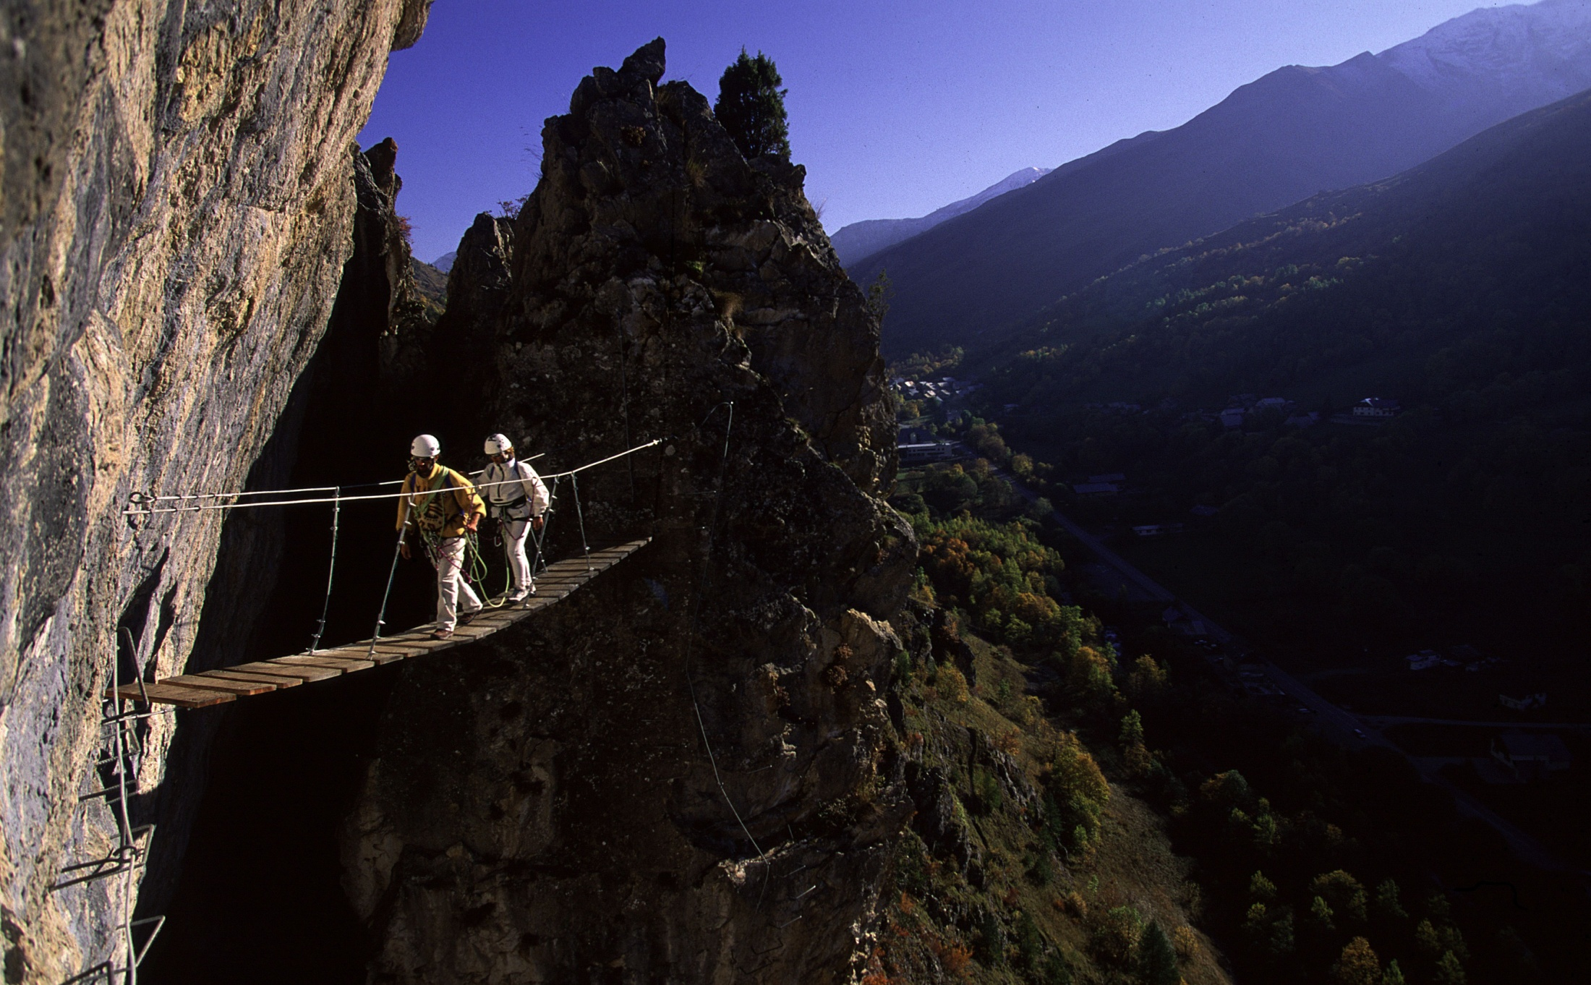
Мир безопасного получения
острых ощущений
Создание условий, чтобы клиенты возвращались снова и снова, что существенно увеличивает доходы
- 5 основных трендов которые мы развиваем в индустрии летнего отдыха
ЭНЕРГИЧНОСТЬ / НОВЫЕ ОТКРЫТИЯ / СВОБОДА /
ОСТРЫЕ ОЩУЩЕНИЯ / БЕЗОПАСНОСТЬ
- Обучение - способствует развитию
Дружба, семейный отдых – единение с детьми
Испытание - преодоление себя
Игровой стиль

Slide 5
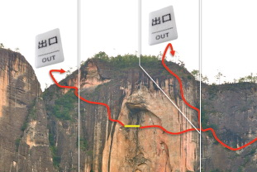
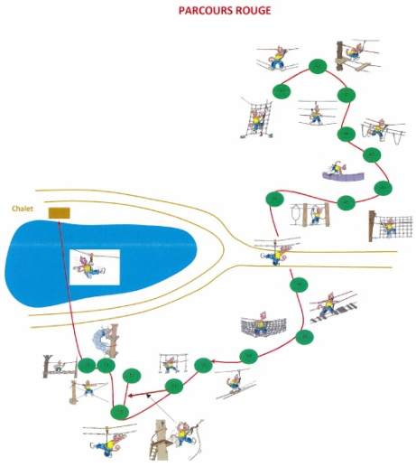
Стадия изучения
Каждый проект уникален и должен проходить через стадию изучения, в процессе которой мы отвечаем на следующие вопросы:
- Экономическое / общественное изучение
- Изучение особенностей окружающей среды
- Искомое количество посетителей
- Емкость
- Тип проектов
- Изучение местности и лесного покрова
- Бюджет и экономический проект
- Способ исполнения
- Крайние сроки

Slide 6
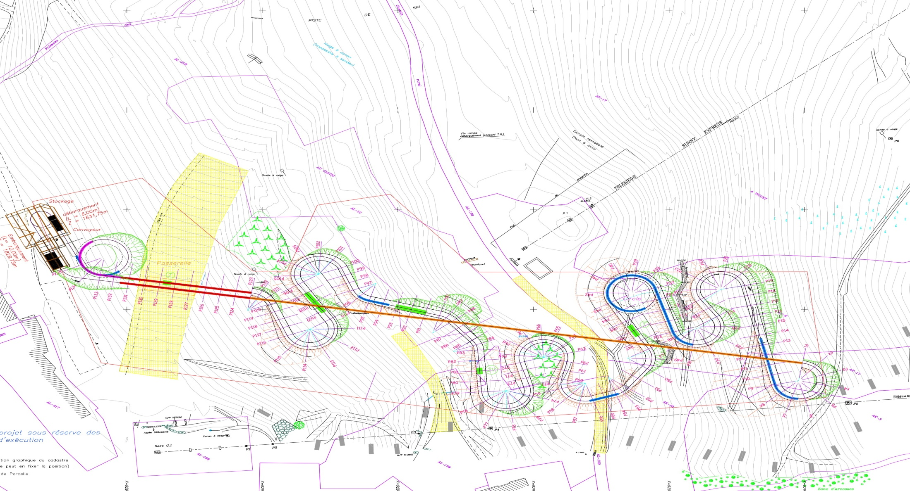
Чертеж спуска

Slide 7
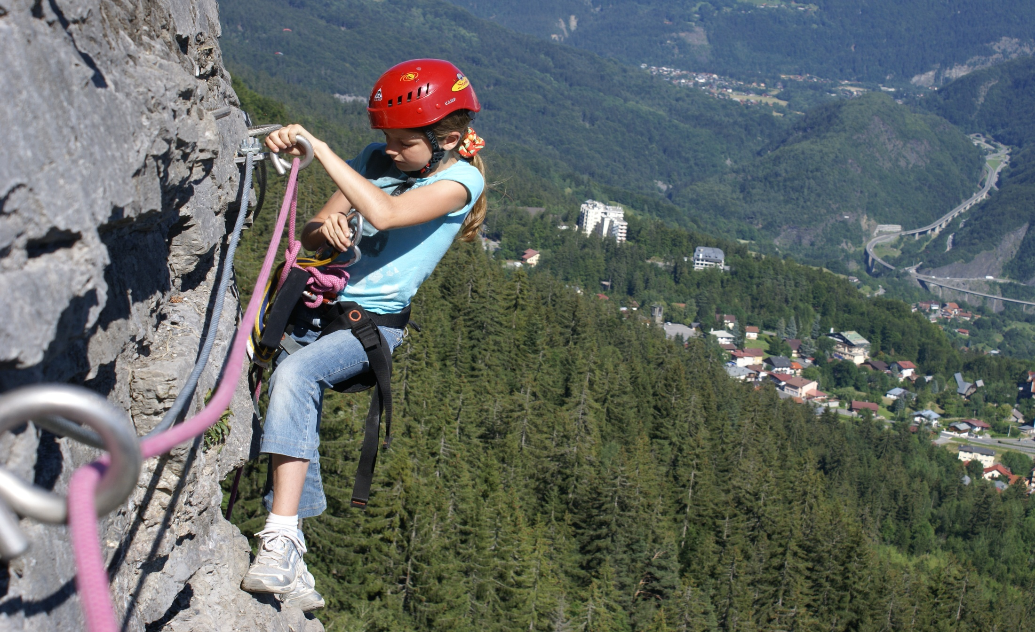
VIA FERRATA (ВИА ФЕРРАТА)
Notes:
Physically demanding or for beginners,
at high altitude or very accessible, vertiginous
or recreational… via ferratas gives to the general
public the opportunity to confront vertical
rock climbing and experience unique
sensations, with only minimal instruction.
Via ferratas first appeared in mountainous areas
but today it can be adapted to other settings.
It breathes new life into tourist facilities pitched
In the sports and leisure market and brings added
value to sites where they are installed.
Why choose TF?
• We have designed and built more
than 100 via ferratas over the past 20 years in Europe,
North America and Asia
• Our equipment is traceable and certified
• We are an Expert Member of the French
and European Standardisation Committees

Slide 8
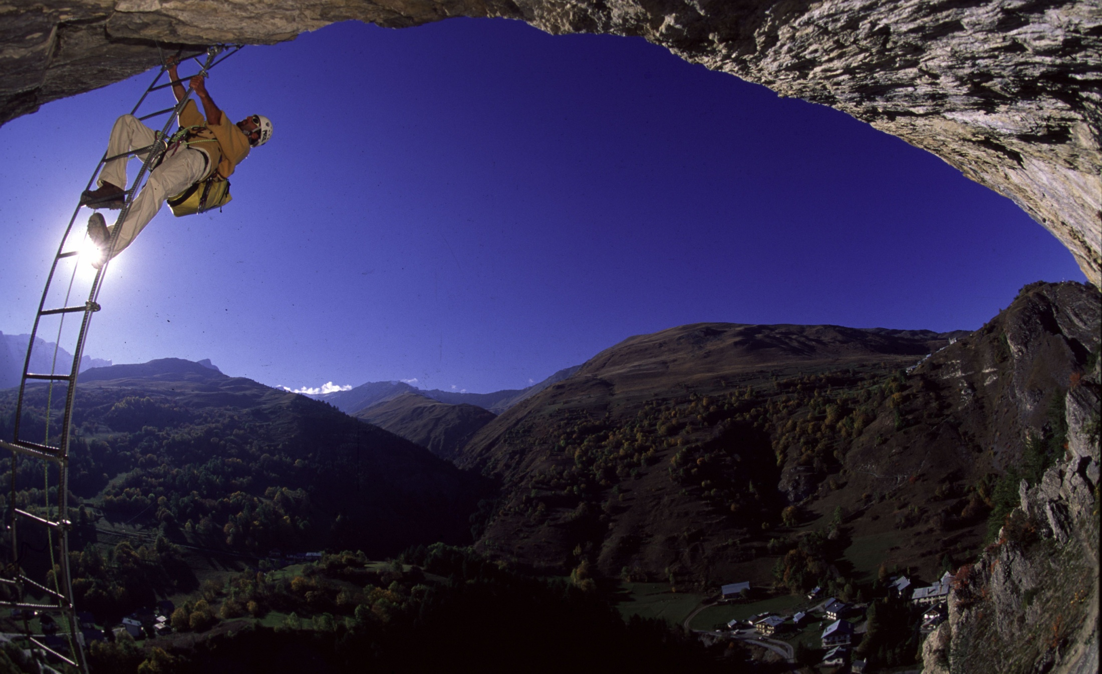
VIA FERRATA (ВИА ФЕРРАТА)

Slide 9
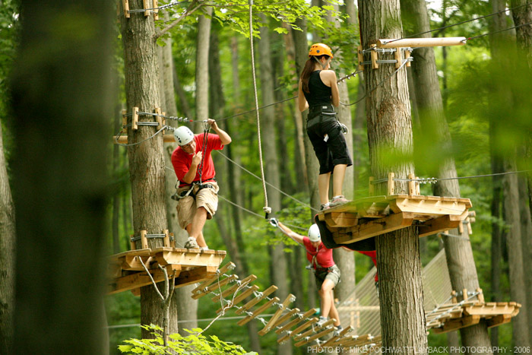
AERIAL COURSE
(ПОДВЕСНЫЕ ПЕРЕХОДЫ)
Notes:
Aerial Courses
Suspended from natural features such
as trees, rocks and cliff faces, or from artificial
structures, our aerial trails bring out the
adventurer that everyone has inside them.
Installed in forests, tourist complexes
or leisure parks, they add an extra dimension
to a site’s tourist and recreational facilities.
Why choose Prisme?
• We have been designing and building aerial
trails for 13 years
• We have installed more than 80 aerial trails
in Europe and North America
• We are an Expert Member of the French
and European Standardisation Committees

Slide 10
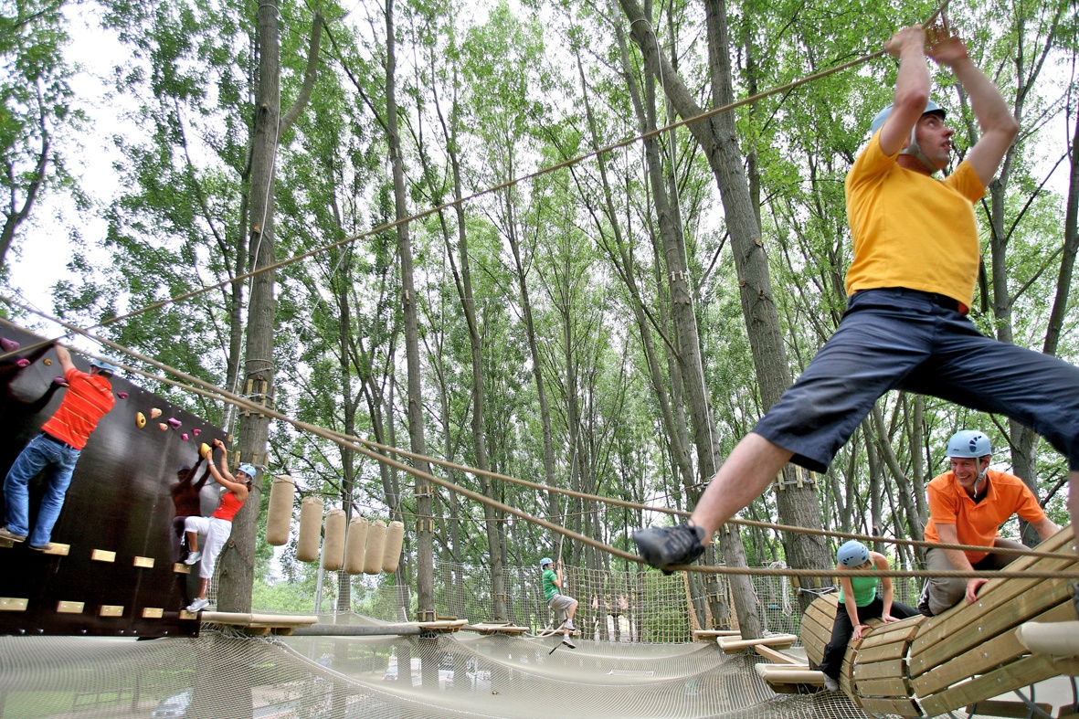
ПОДВЕСНЫЕ ПЕРЕХОДЫ
НАД СЕТЯМИ

Slide 11
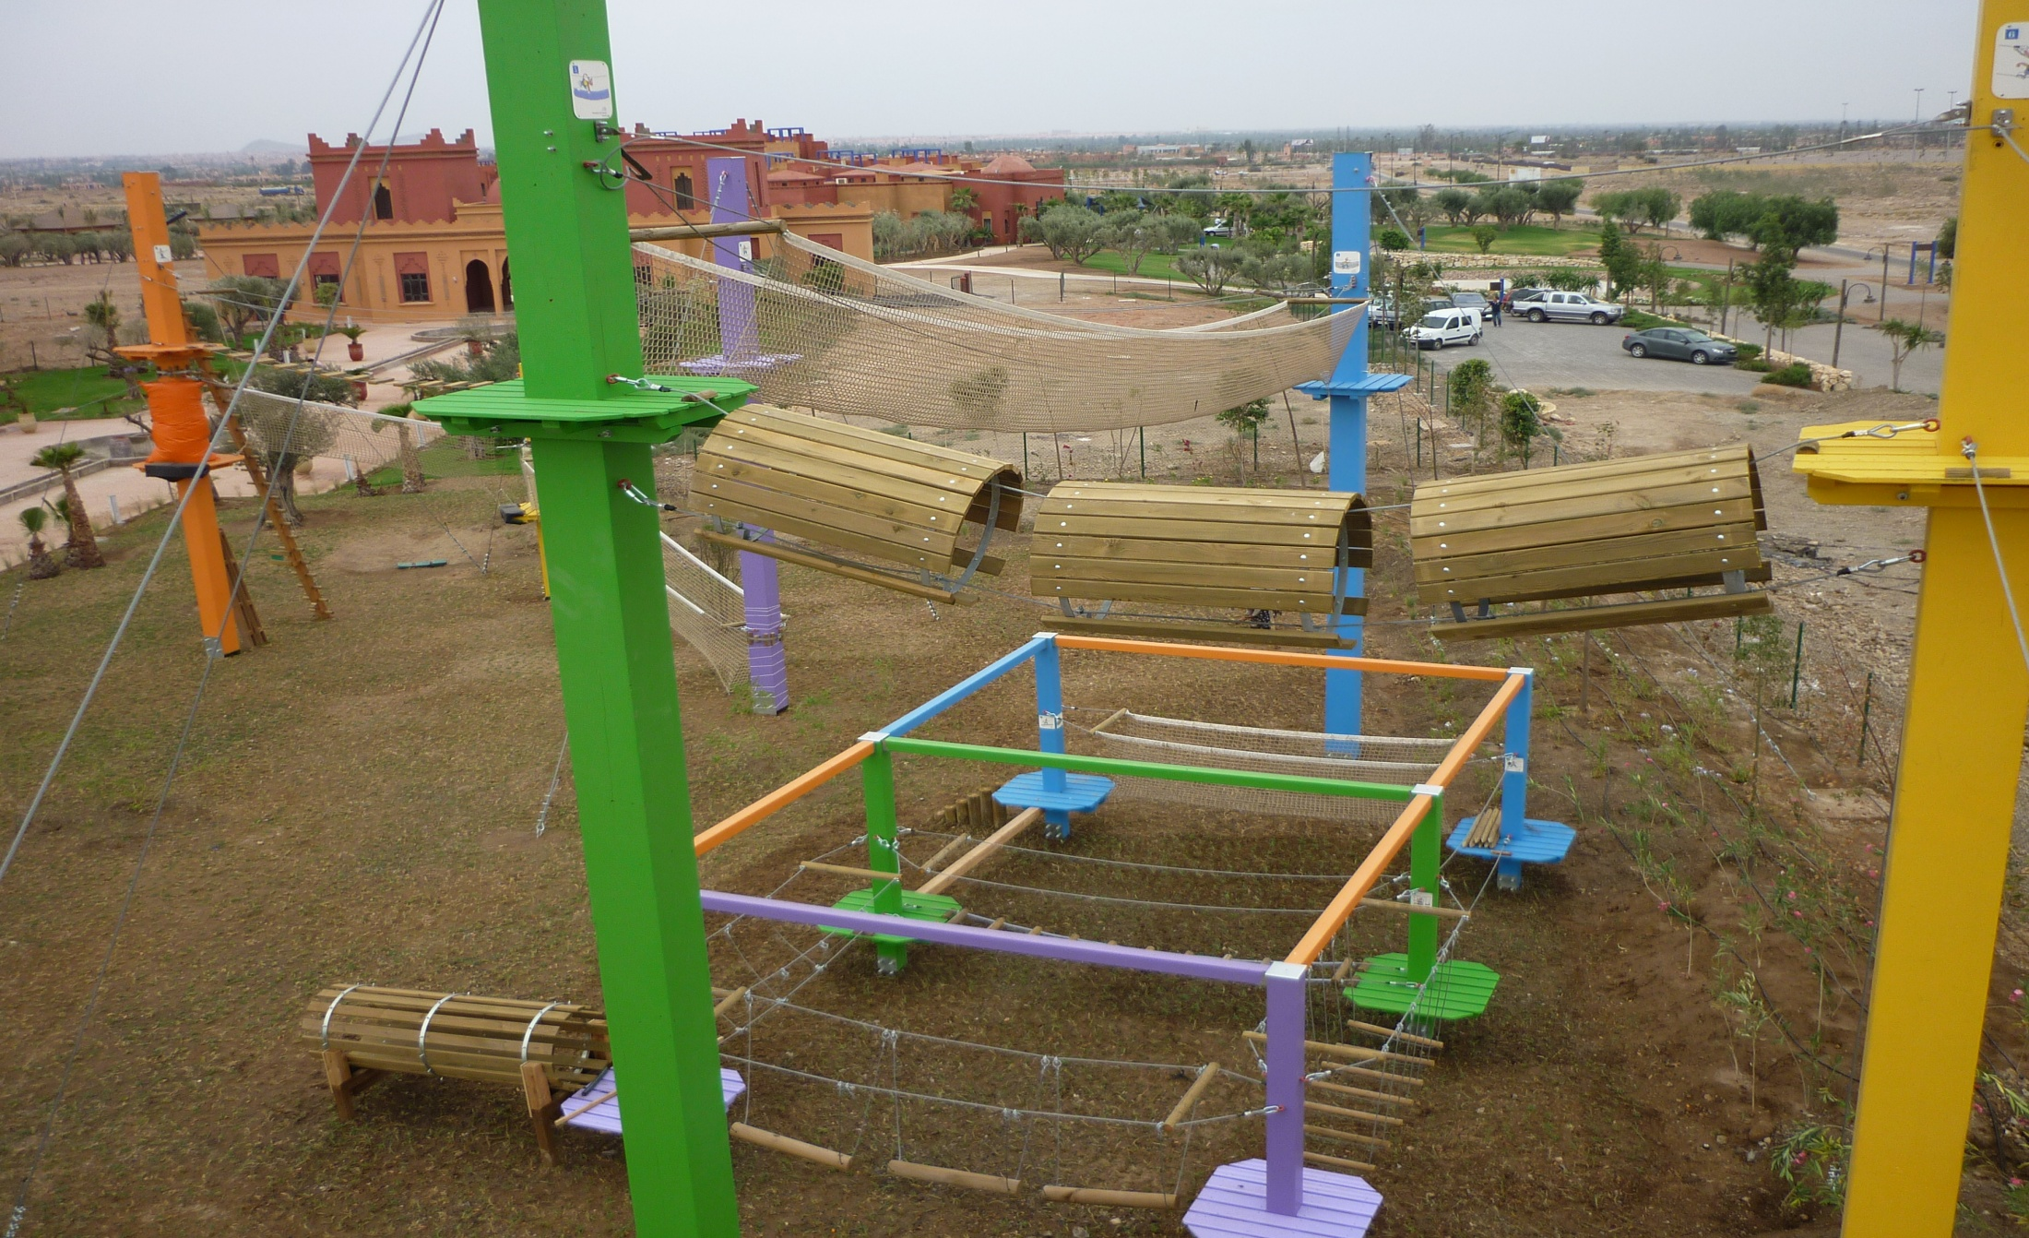
ПОДВЕСНЫЕ ПЕРЕХОДЫ
НА ИСКУСТВЕННЫХ МАЧТАХ
Notes:
One hundred adventure parks have been built by us.
Continous Life line or connectors
When there are no trees

Slide 12
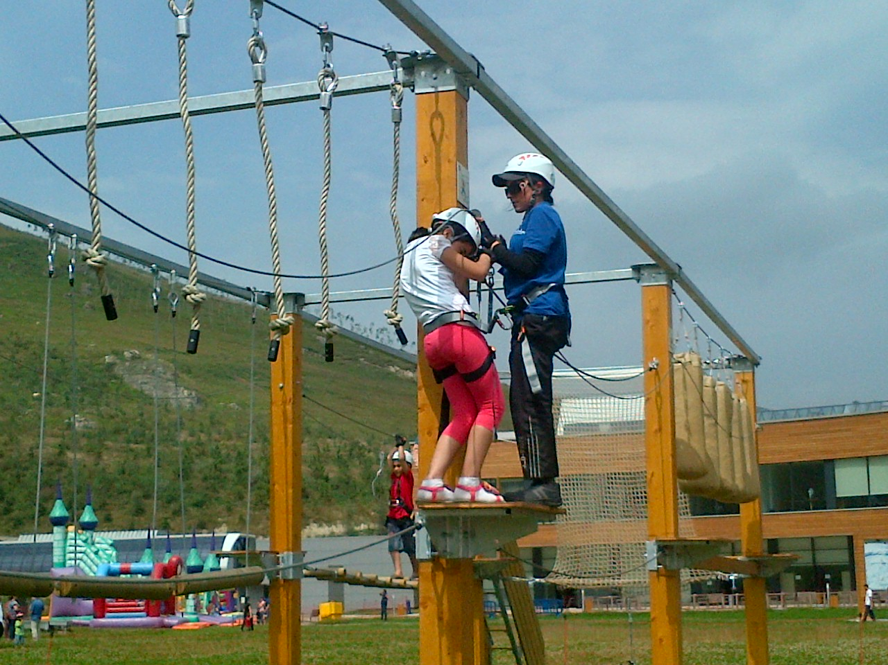
СЪЕМНЫЕ ПАРКИ ПРИКЛЮЧЕНИЙ
Notes:
Removable adventure parks

Slide 13
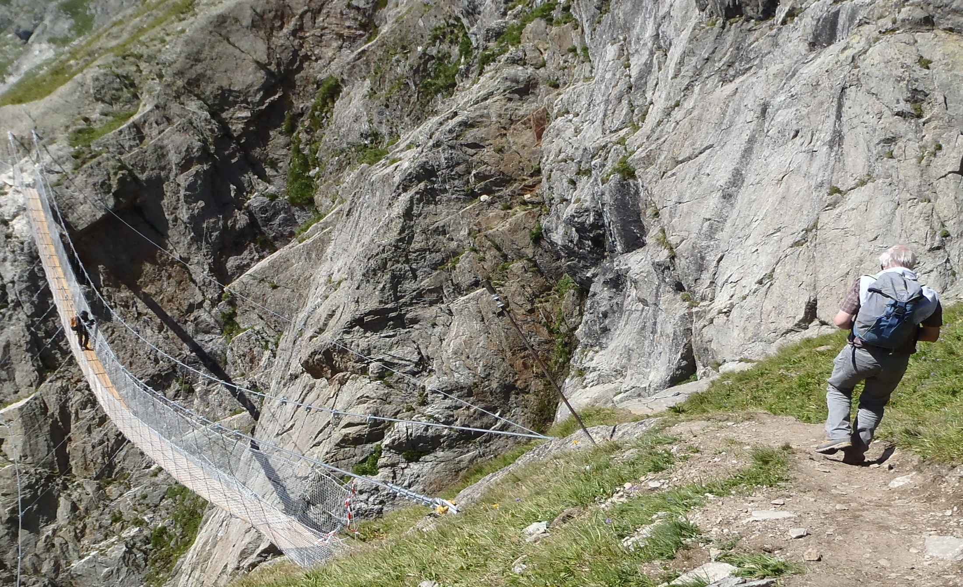
ПОДВЕСНЫЕ МОСТЫ
Notes:
Outdoor tourist installations
Walkways, aerial bridges, viewing platforms,
cliffside paths and more… These are all
installations that give the general public
access to safe walking routes in remarkable,
spectacular and often inaccessible places.
Outdoor tourist installations are a way
of creating, developing and enhancing
the attractiveness of natural tourist attractions
and monuments, regardless of how they
are arranged.
Why choose Prisme?
• We integrate our designs into the landscape
and environment
• We provide a bespoke design and sizing service
• We have a specialized difficult-access work team

Slide 14
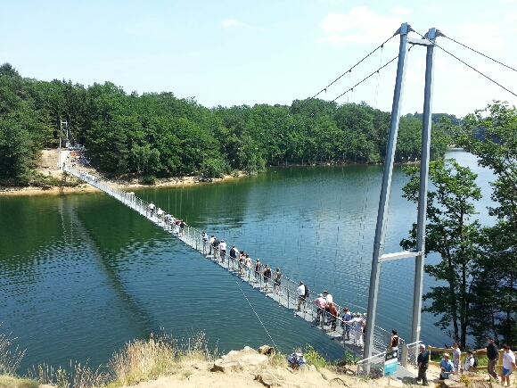
ПОДВЕСНЫЕ МОСТЫ

Slide 15
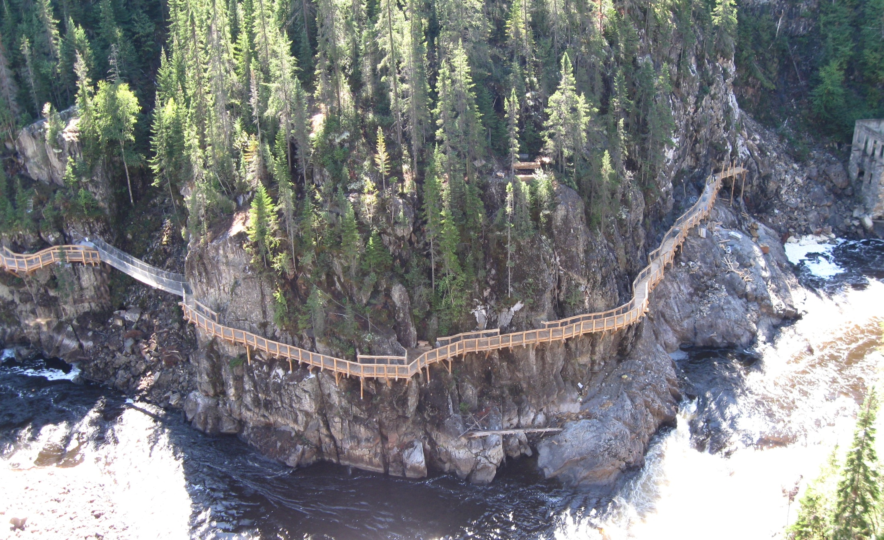
ПОДВЕСНЫЕ ПЕРЕХОДЫ
HEIGHT - OUTDOOR

Slide 16
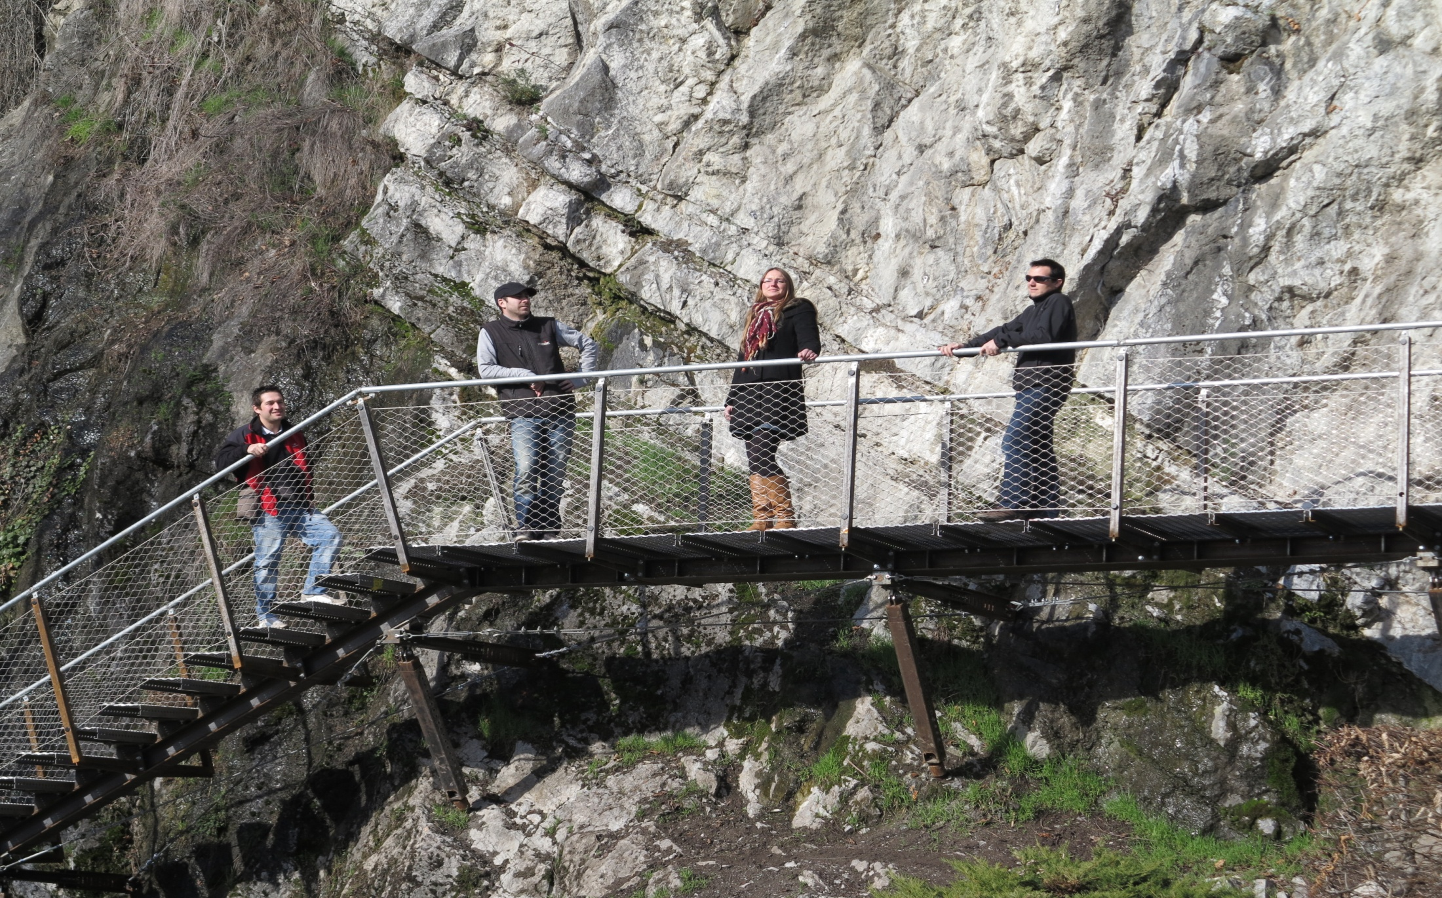
ПОДВЕСНЫЕ ПЕРЕХОДЫ

Slide 17
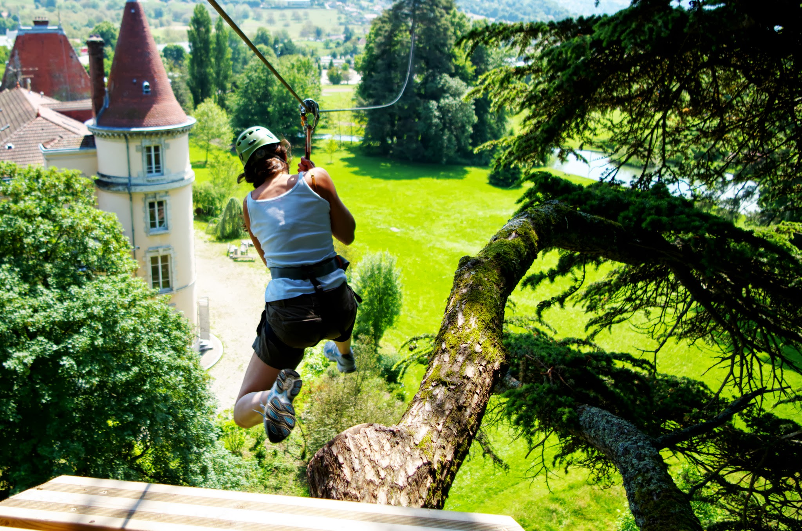
ZIPLINE
Notes:
La tyrolienne est au carrefour de nos deux passions, la hauteur et la pente.
La Tyrolienne procure des sensations uniques. Dénués de difficultés plusieurs dizaines de passages successifs dans la même journée.
La force de Prisme :
• Plusieurs centaines de tyroliennes ont été crées et installées par Prisme
• Dans cet exercice l’expérience est primordiale. La sécurité est un critère évident.

Slide 18
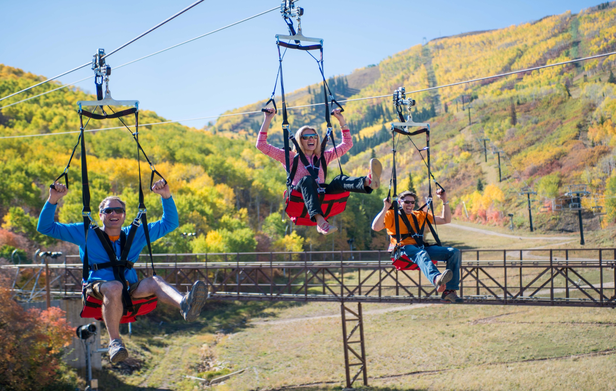
ZIPRIDER / ZIPTOUR
Notes:
Welcome to the world's most exciting “No-Sweat Adrenaline™” zip line ride. The ZipRider® zip line cable ride is based on the familiar concept of the back yard zip line, but from there it takes a giant leap beyond anything you may have thought possible. The key lies in the ZipRider® trolley, a device designed to automatically brake while the rider descends cable gradients ranging from 5% to 40%.
With the creation of the ZipRider®, a whole new world of sky travel is possible. This device has allowed us to build extraordinary zip lines over a mile long that run at speeds up to 65 MPH! Our patented and exclusive ZipRider® “Equipment Retrieval System” drives tremendous profits by increasing rider throughput while enhancing the ride safety and reducing operator expenses, error and fatigue.
The ZipRider® can adapt to almost any location. Whether you are located in a mountainous environment or on level terrain, the ZipRider® can accommodate your year-round revenue producing needs. Our engineering capabilities allow us to design a ride that is tailored to your needs and designed with your money-making opportunities in mind.

Slide 19
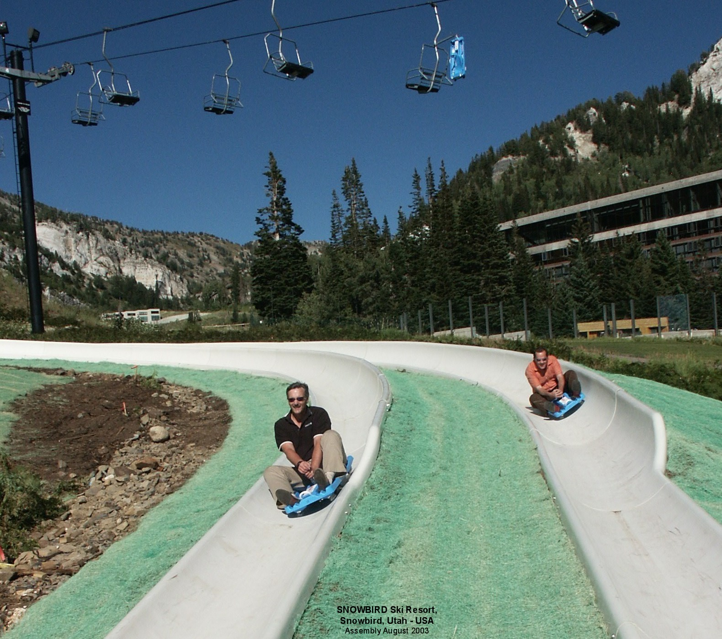
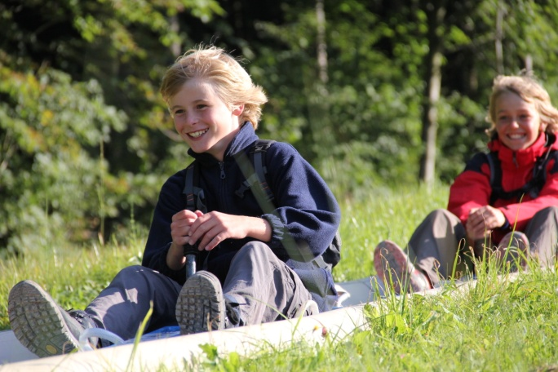
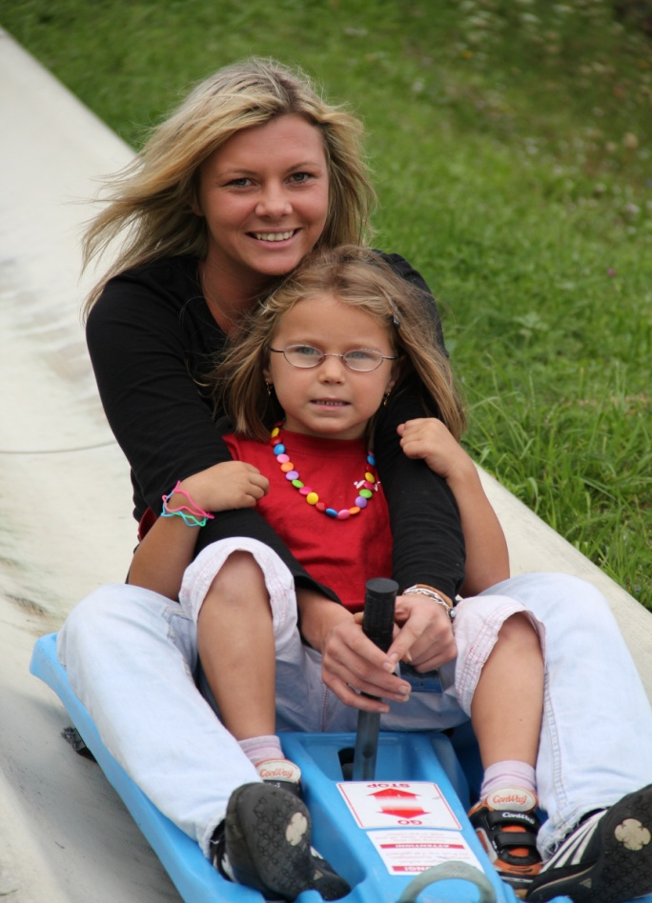
СПЕЦИАЛИЗИРОВАННАЯ ТРАССА:
АЛЬПИН СЛАЙД
Notes:
An alpine slide is a long chute on the side of a hill, usually built by ski resorts to supplement summer income. A wheeled cart is used to navigate the slide. The ride is similar to a bobsled ride, except that it rolls over a smooth track — generally cement, stainless steel, or fiberglass — rather than sliding on ice. The cart accommodates one or two passengers and is controlled by a hand brake located between the rider's legs. Pulling the hand brake handle causes the cart to stop; pushing or letting go of the handle causes the brakes to release, allowing the cart to accelerate. The ride is unique among amusement park rides in that the rider has complete control over his or her speed and ride experience. With this control comes responsibility: the rider must ensure the cart is not going too fast, otherwise the cart may overturn around curves, leading to possible injury or deat
Why choose TechFun
More than 120 km of slope had been installed by our company.

Slide 20
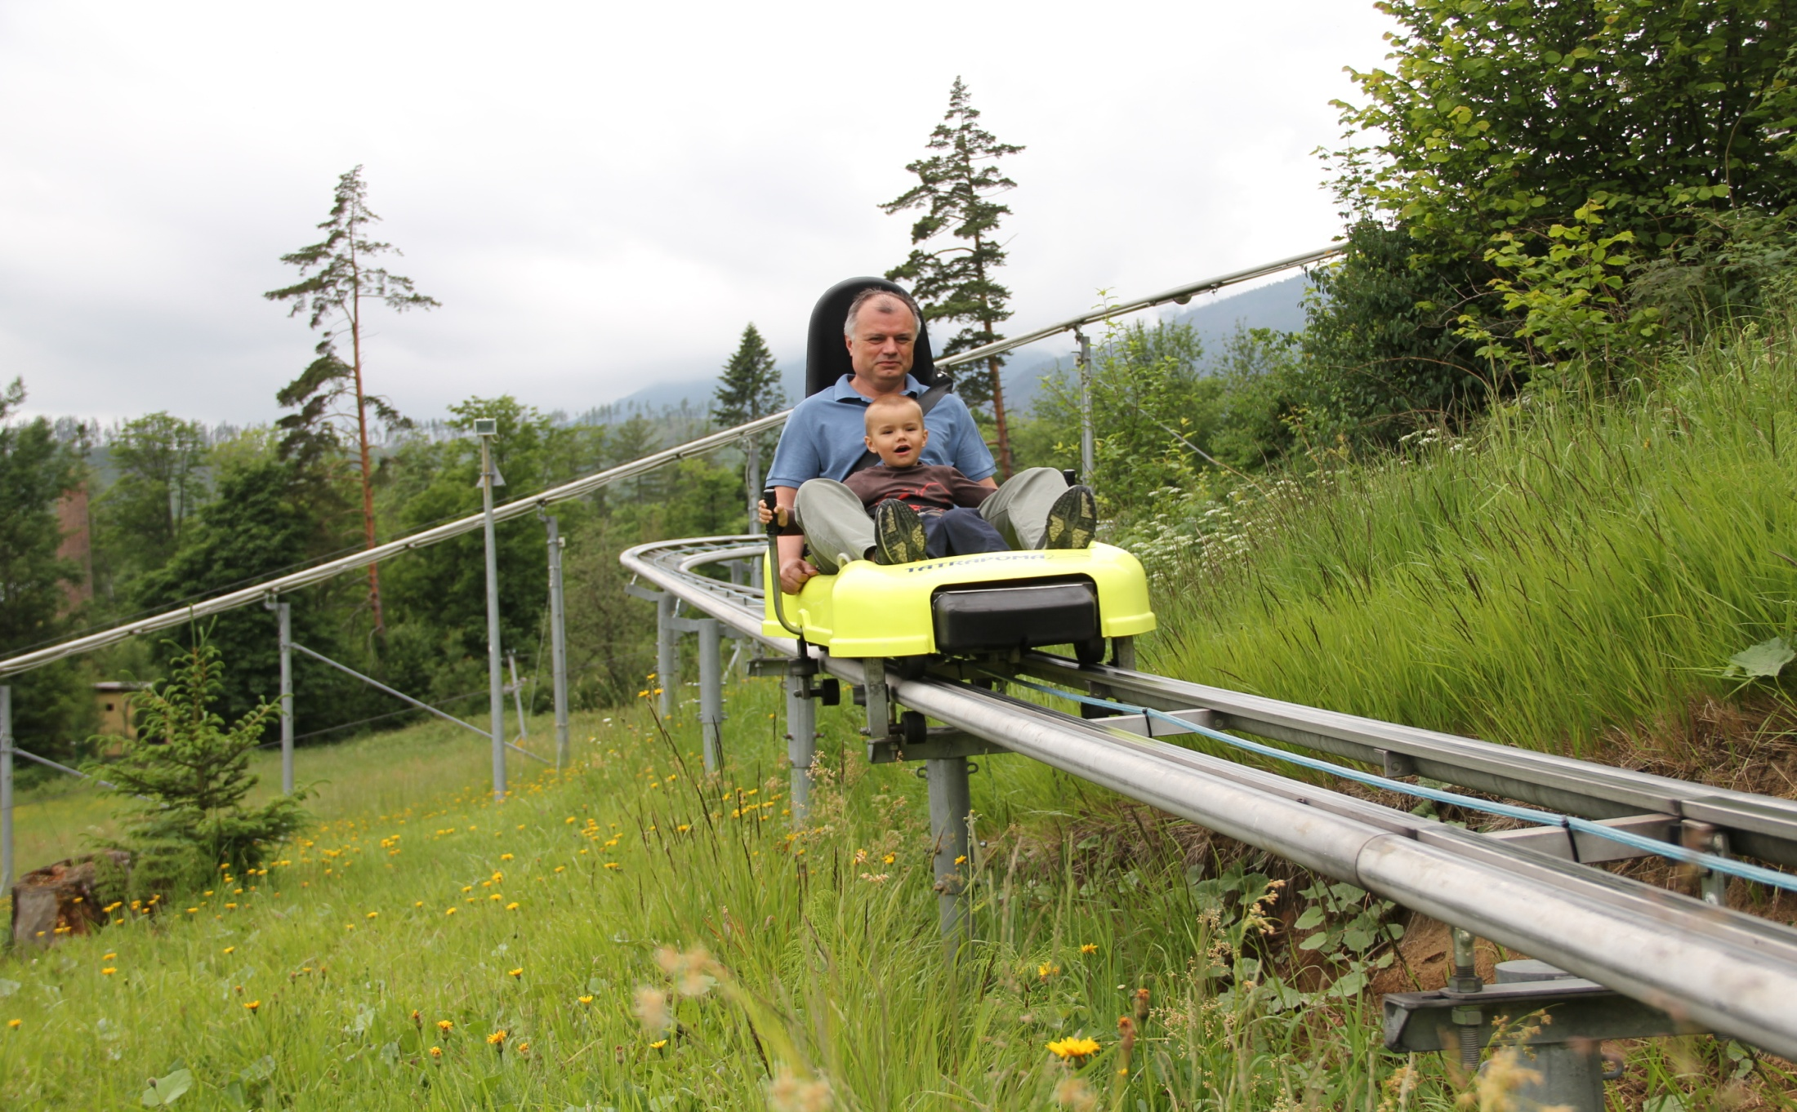
СПЕЦИАЛИЗИРОВАННАЯ ТРАССА: АЛЬПИН КОСТЕР
Notes:
COASTER is a mountain gravitational track and can be operated throughout the year.
Track of COASTER is designed as Start-Stop track, without interruption.
Passenger directly controls speed and distance between each coaster bob on the track.
Why choose TechFun
9 Coaster have been build for now . The last is in the Ménuires in the 3 vallées will be one of the most famous coaster in the world thanks to CDA which He use the skills decorations of CDA branch to stage it.

Slide 21
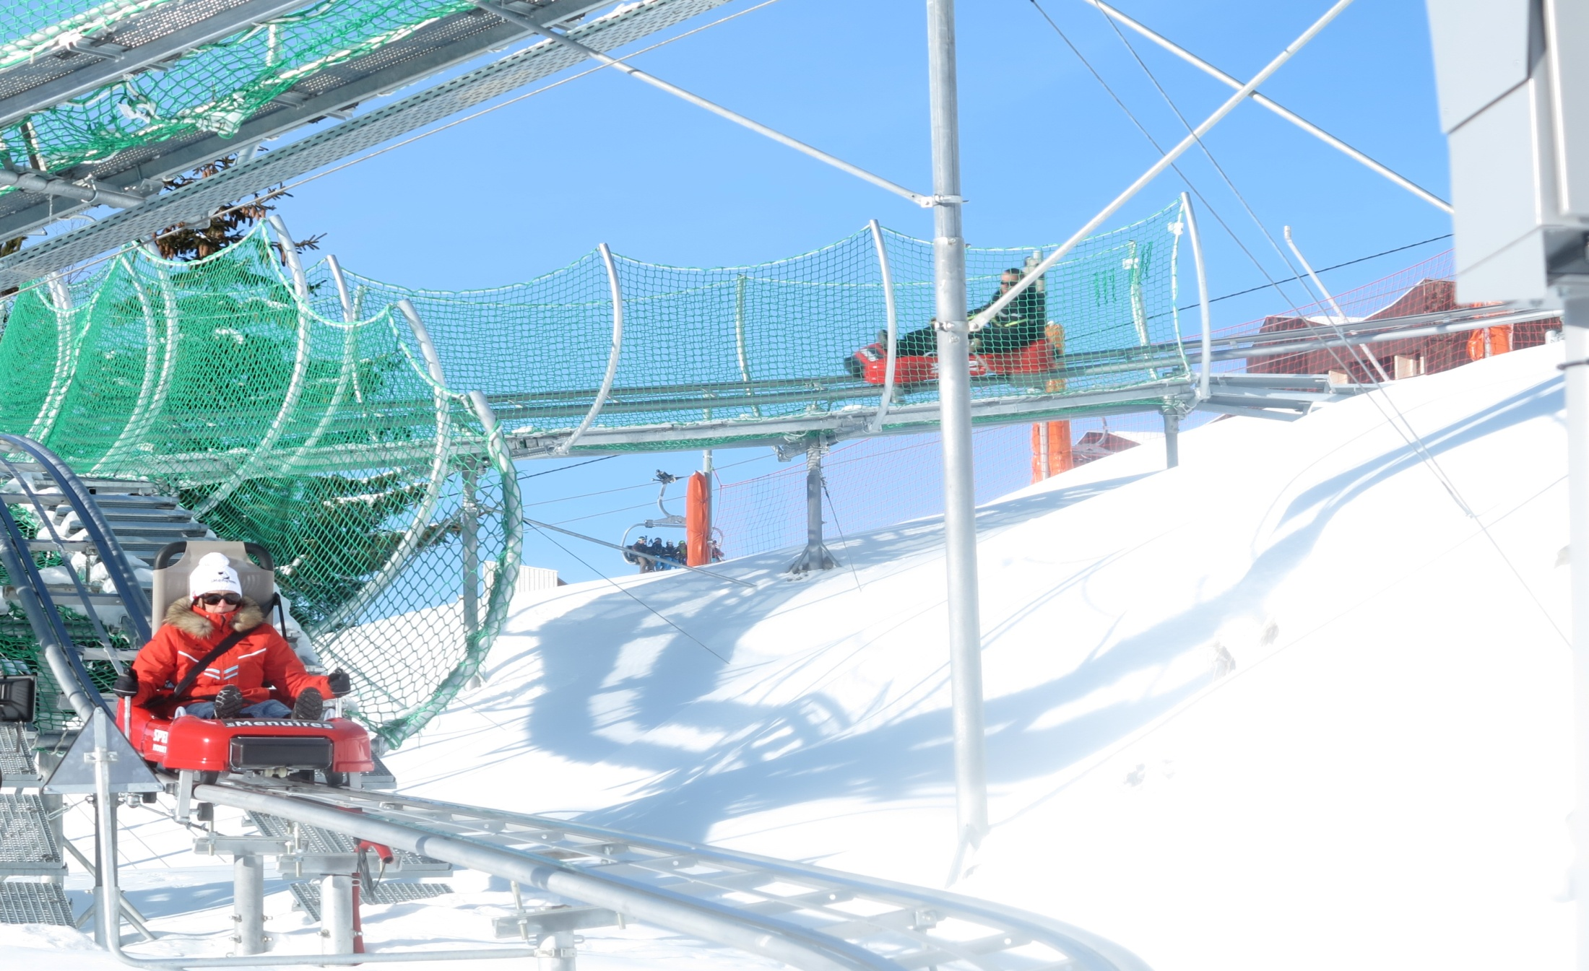
СПЕЦИАЛИЗИРОВАННАЯ ТРАССА: АЛЬПИН КОСТЕР

Slide 22
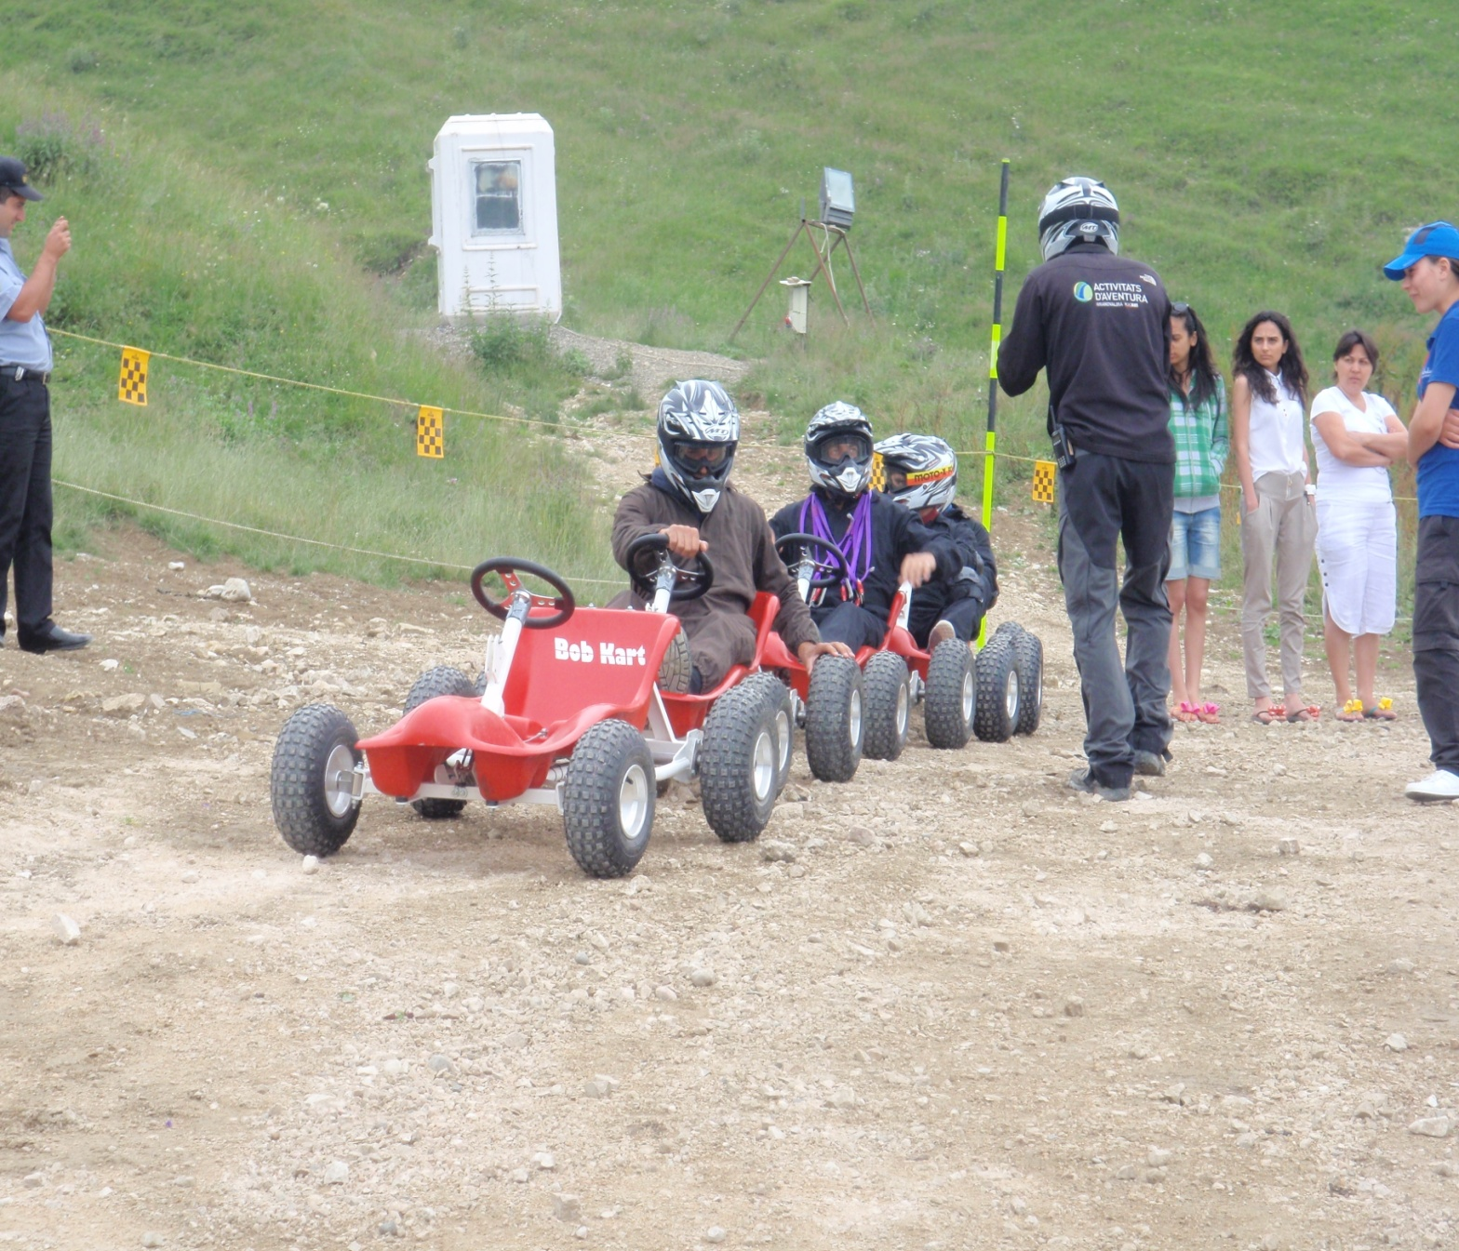
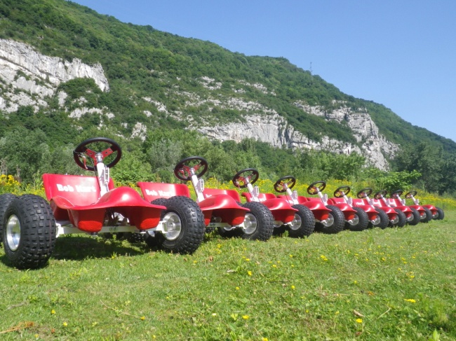
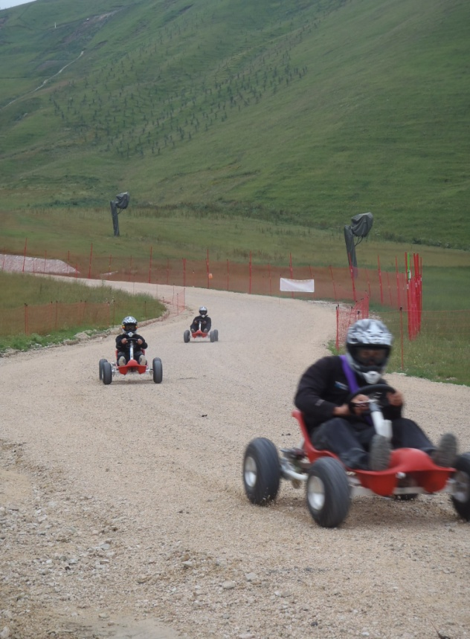
BOB KART (КАРТИНГ ДЛЯ СПУСКА СО СКЛОНОВ)

Slide 23
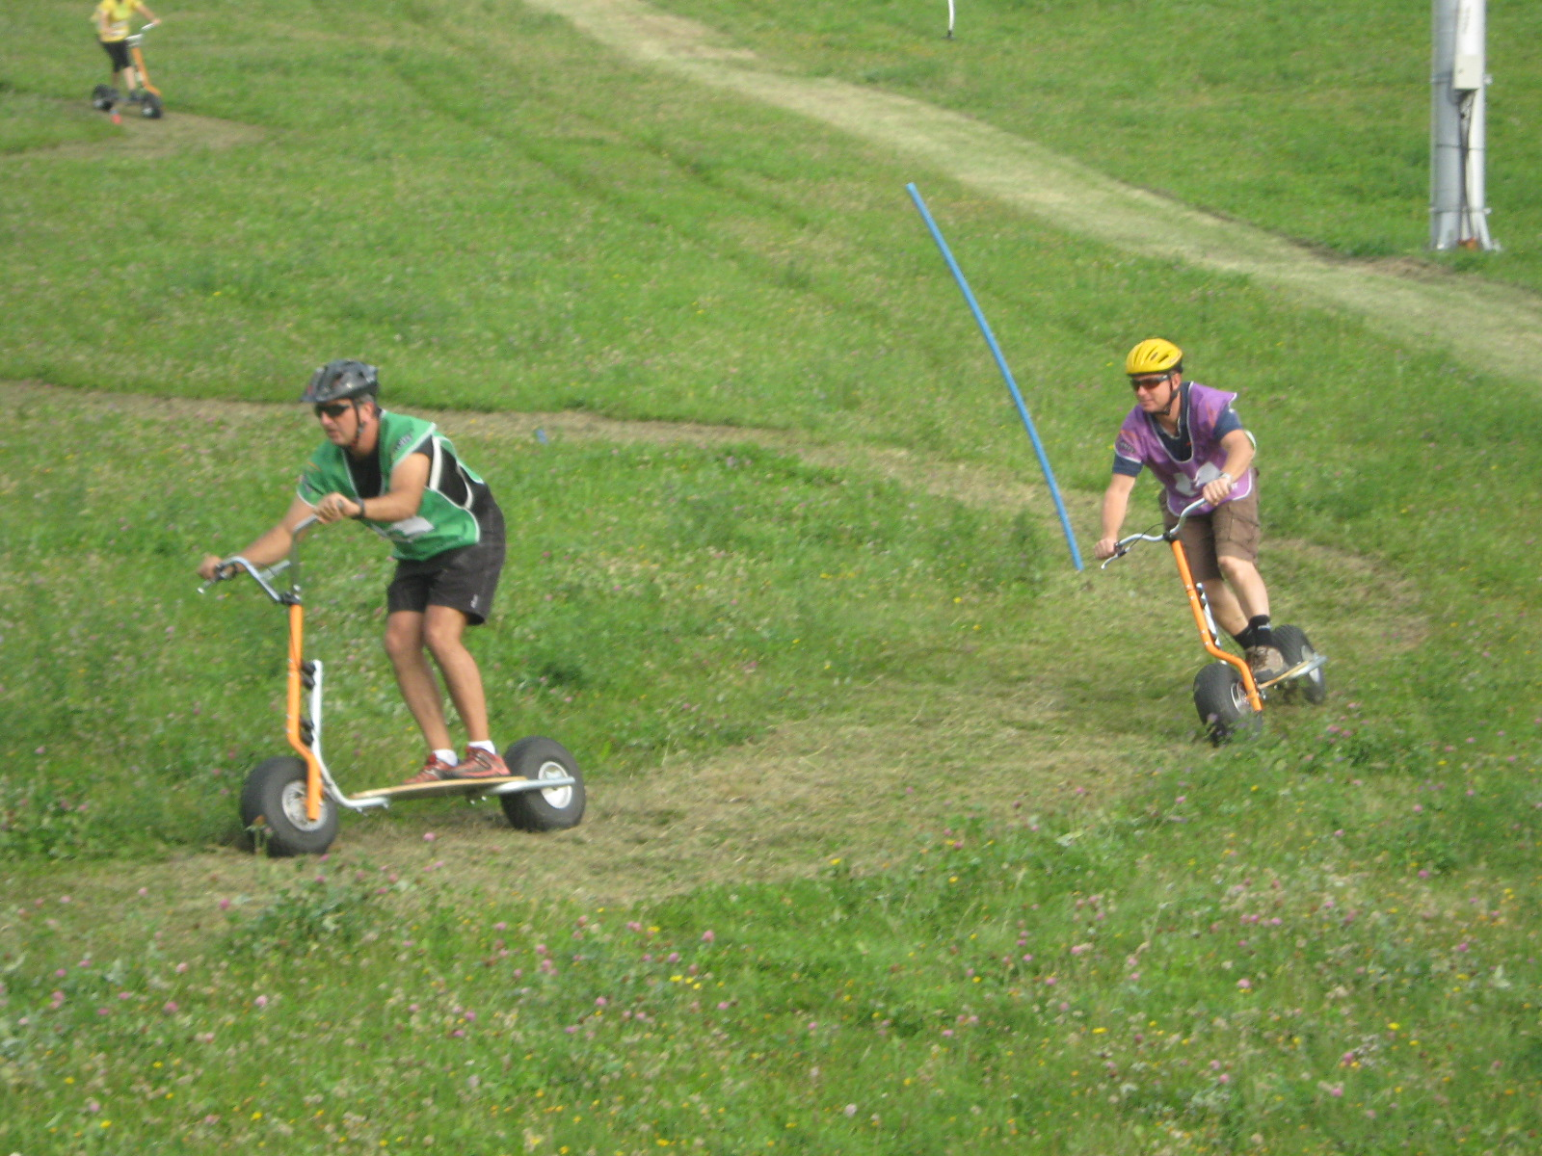
САМОКАТ ДЛЯ СПУСКА СО СКЛОНОВ

Slide 24
ГОРНЫЙ ВЕЛОСИПЕД

Slide 25
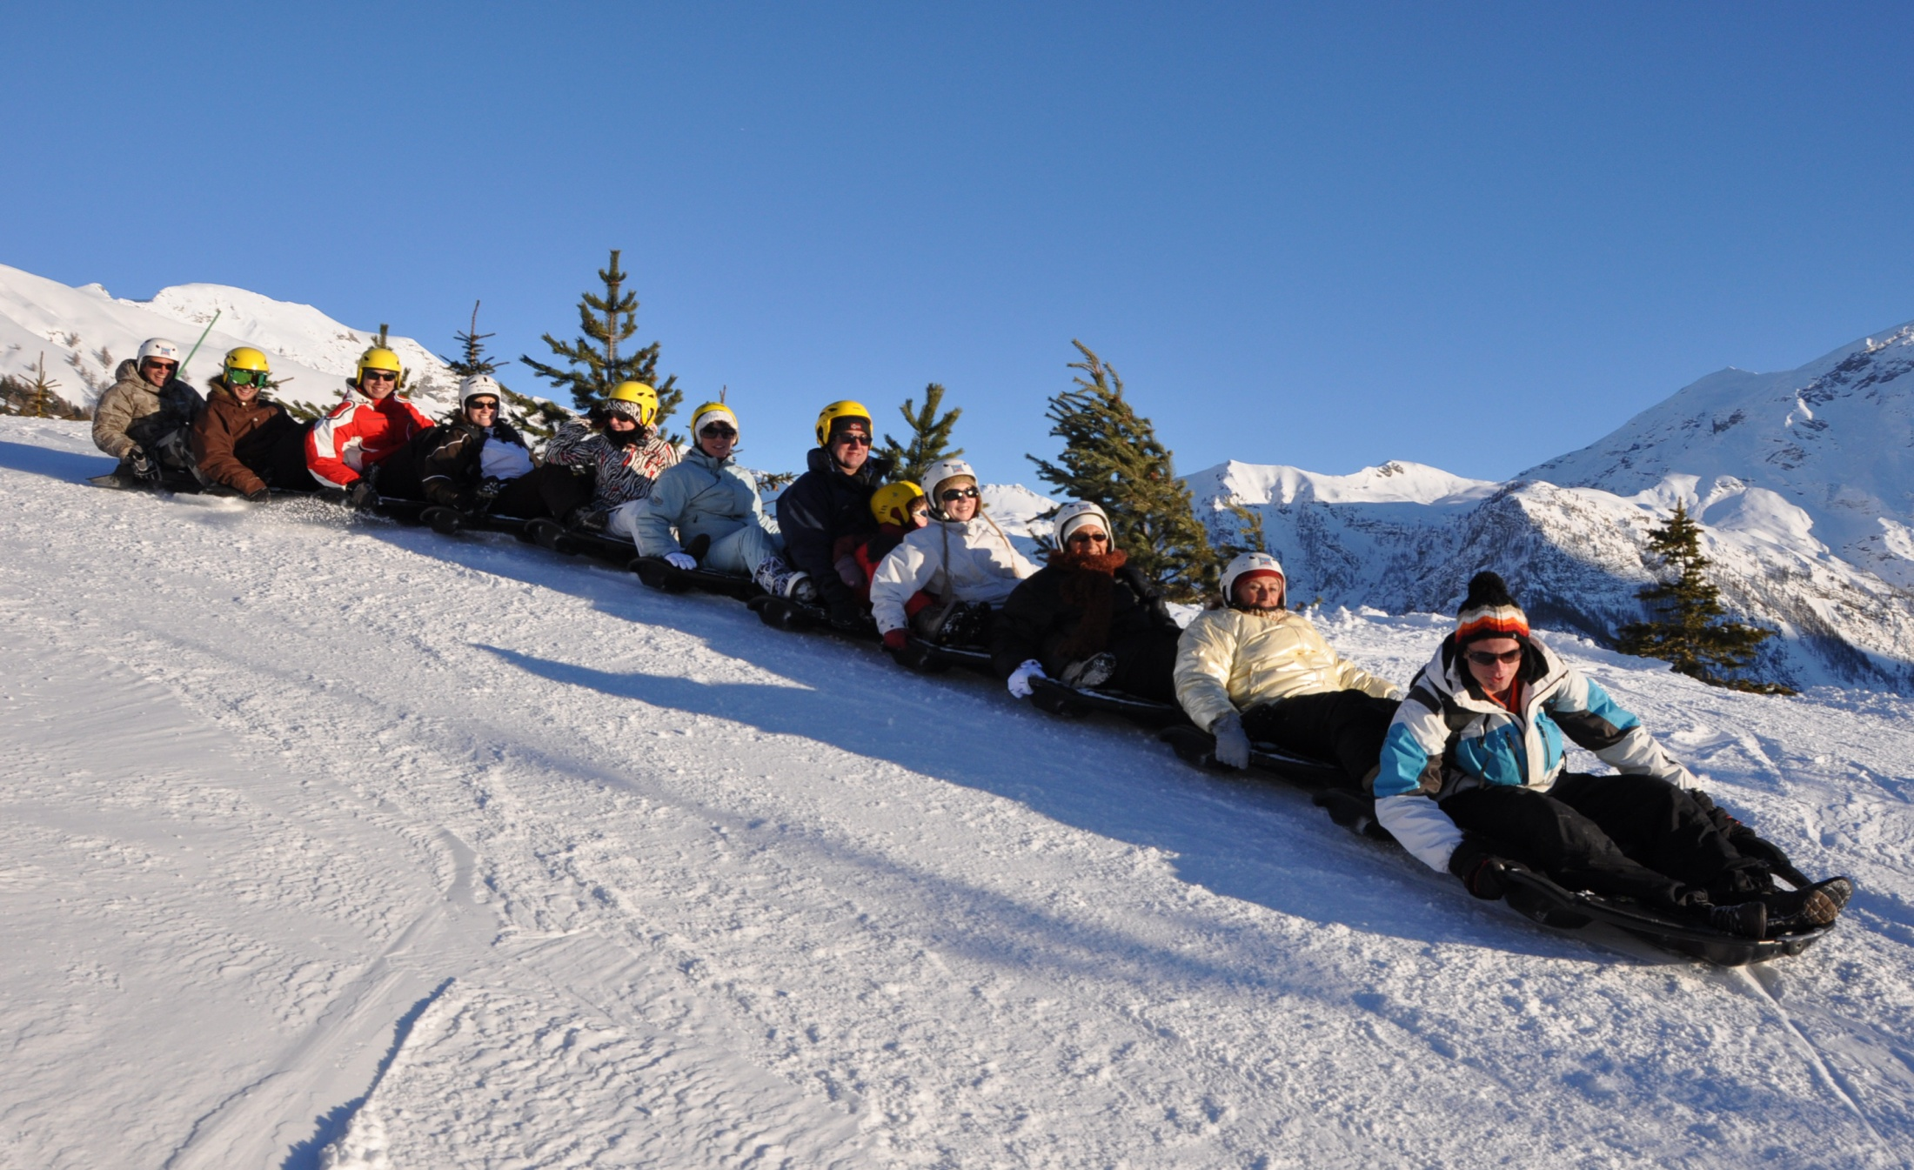
SNAKE GLISS (ЗМЕЙКА)
Notes:
La luge est une activité d'après ski qui touche toutes les générations. Le Snake-Gliss, luge collective ou Rando luge comme nous l'appelons, fait à présent partie des activités après ski incontournables de la montagne. Il est désormais possible d'accéder aux pistes de ski, par les remontées mécaniques pour la pratique de cette activité.
Le concept
Les luges, toutes identiques, s'assemblent les unes aux autres pour former un seul et unique train piloté par un guide.
Celles-ci s'assemblent par un axe amovible qui va permettre au train d'effectuer de vrais virages et de procurer des sensations inédites. C'est là que réside tout l'attrait de ce concept! Assis dans votre luge, vos deux pieds seront positionnés dans la luge située devant vous. Ainsi, ce n'est pas plusieurs luges mais une seule luge sur laquelle tout le monde devra participer pour que l'ondulation soit fluide!

Slide 26
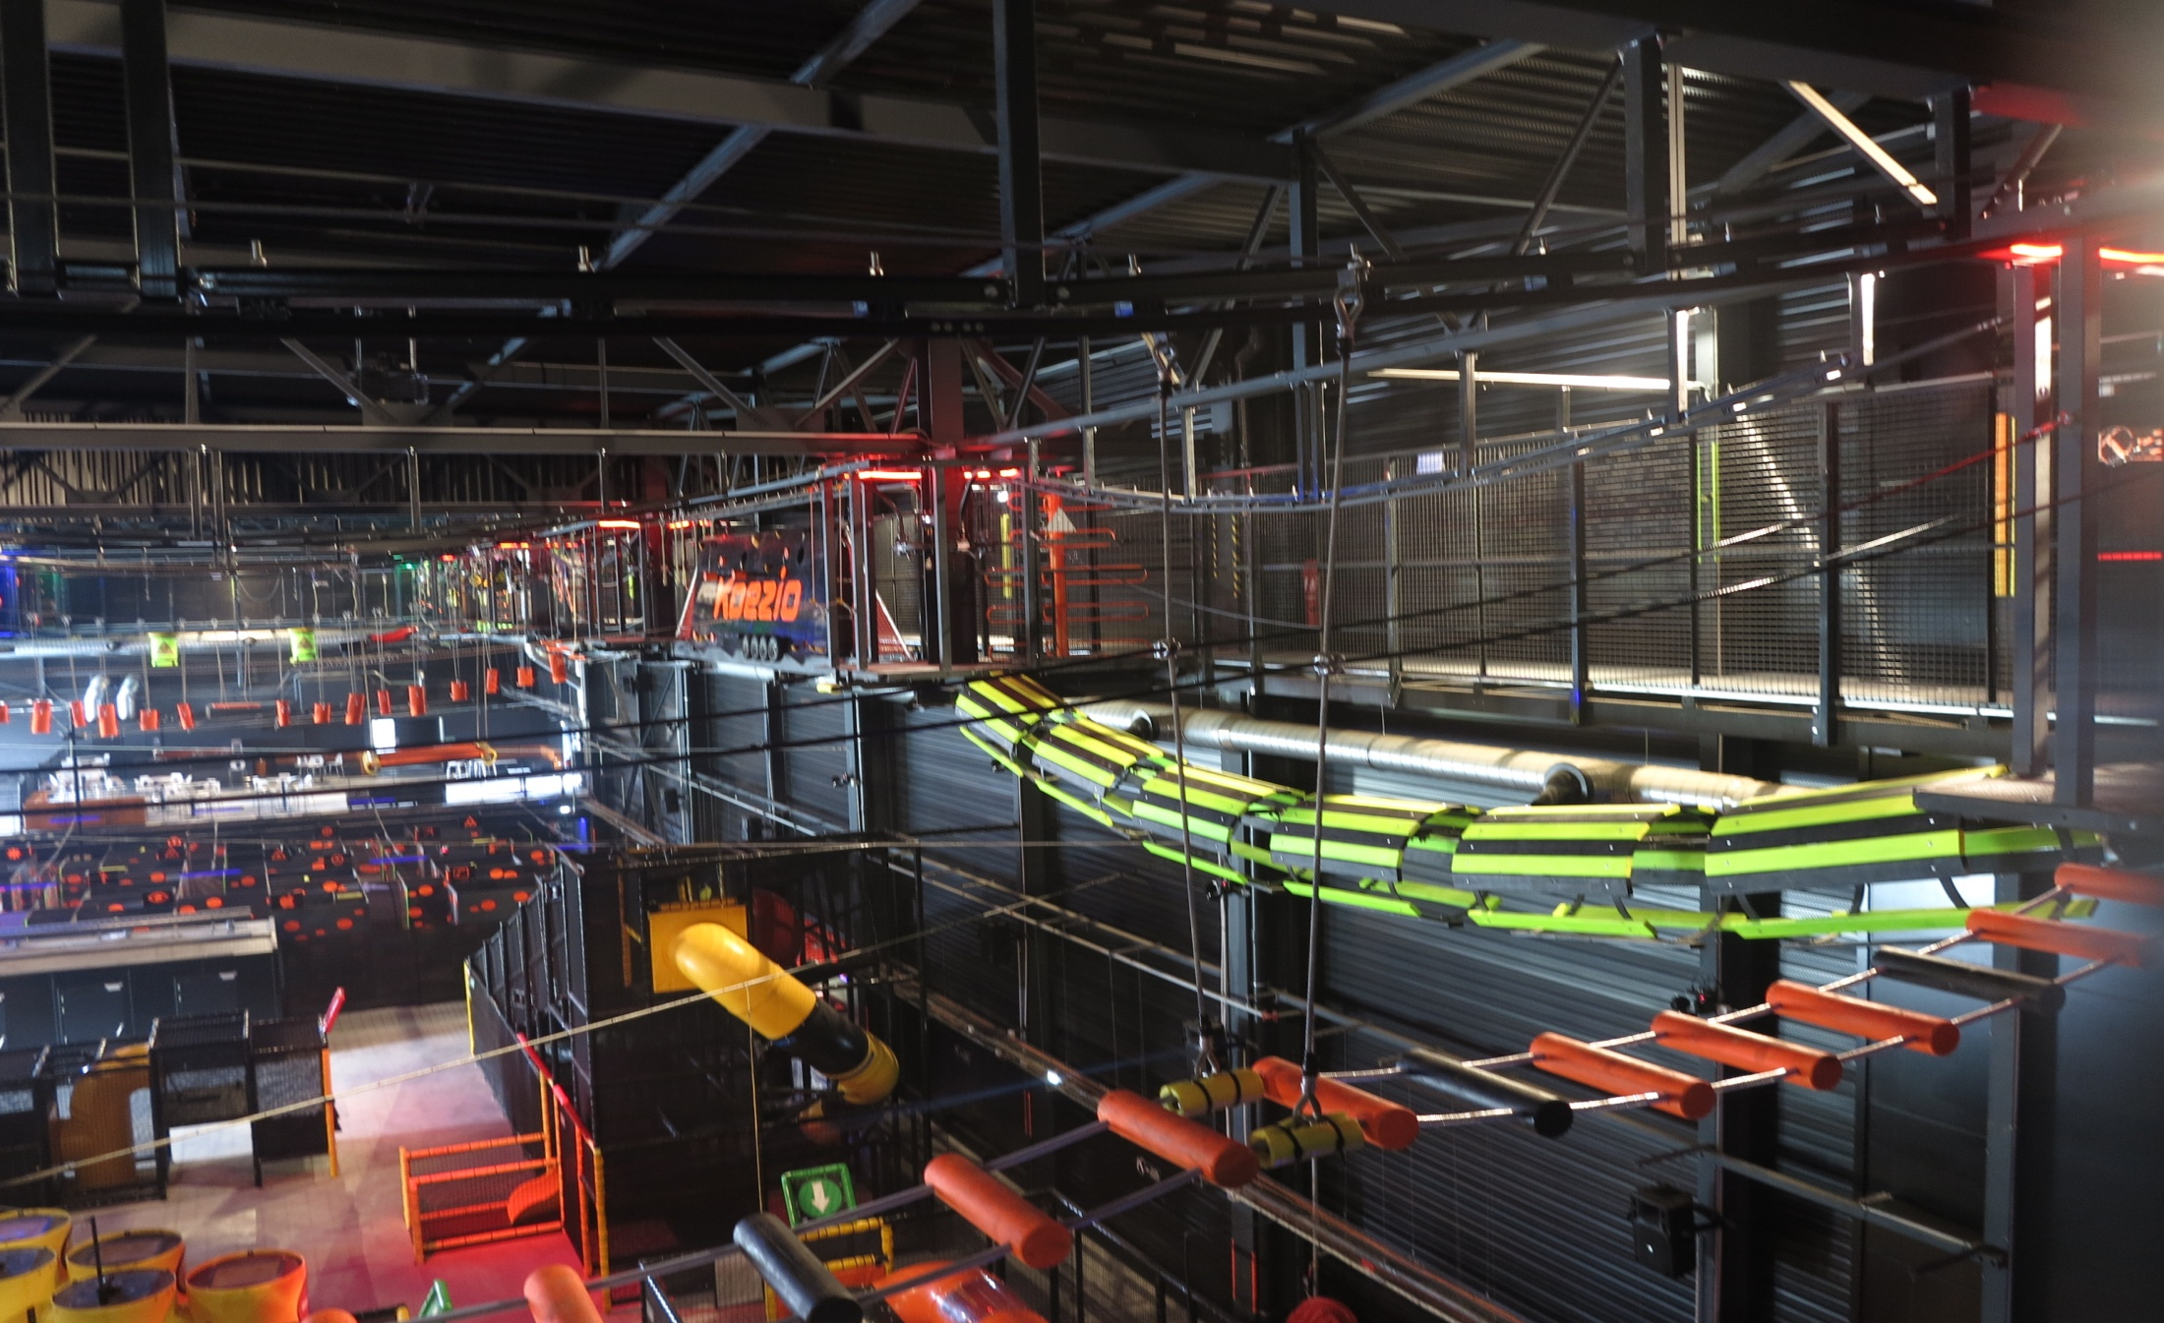
KOEZIO (КОЗЕО)

Slide 27
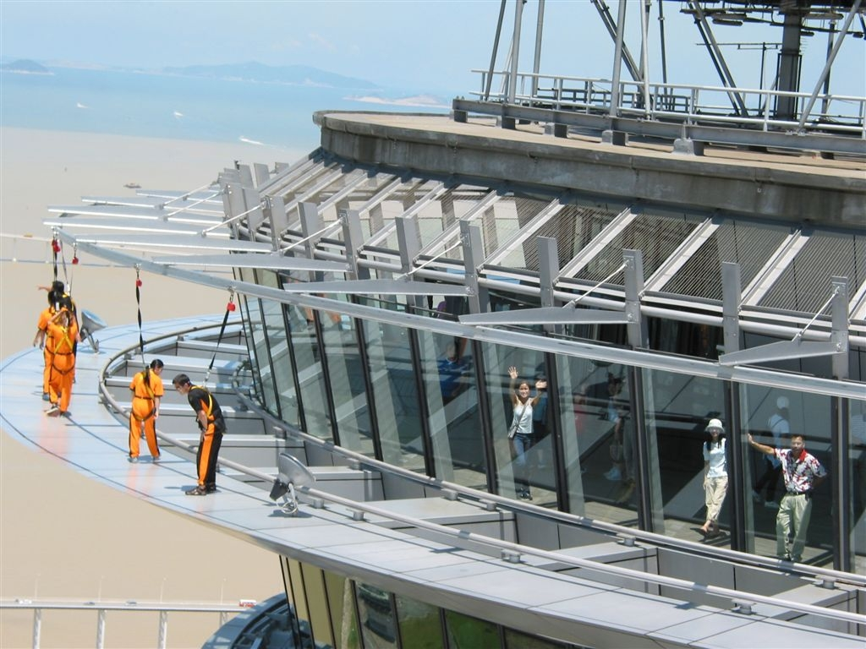
ГОРОДСКИЕ ПРИКЛЮЧЕНИЯ МАКАУ
Notes:
SKYWALK X
Look! No handrail! A very thrilling walk around the main outer rim of the tower, 233 meters above ground. Safety is guaranteed by a world-first overhead rail system.
Available individually or in group.

Slide 28
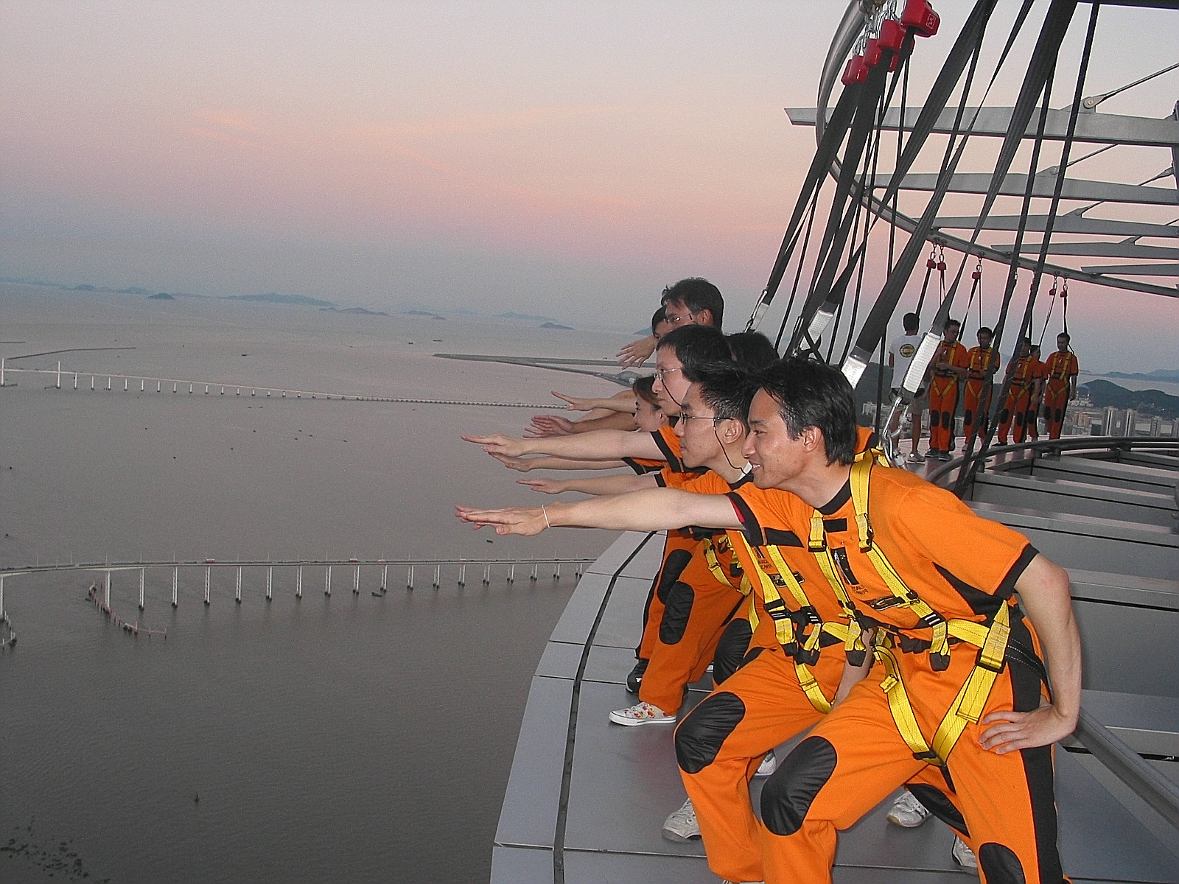
ГОРОДСКИЕ ПРИКЛЮЧЕНИЯ МАКАУ

Slide 29
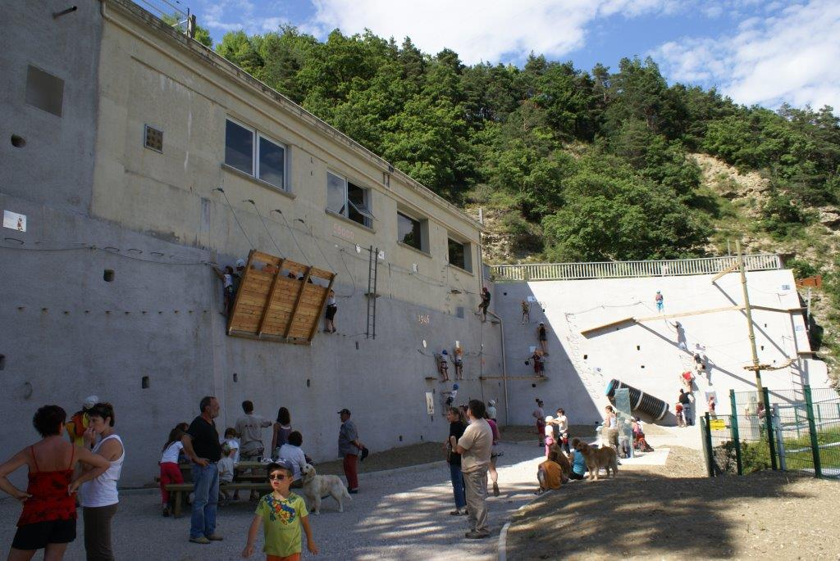
ГОРОДСКИЕ ПРИКЛЮЧЕНИЯ

Slide 30
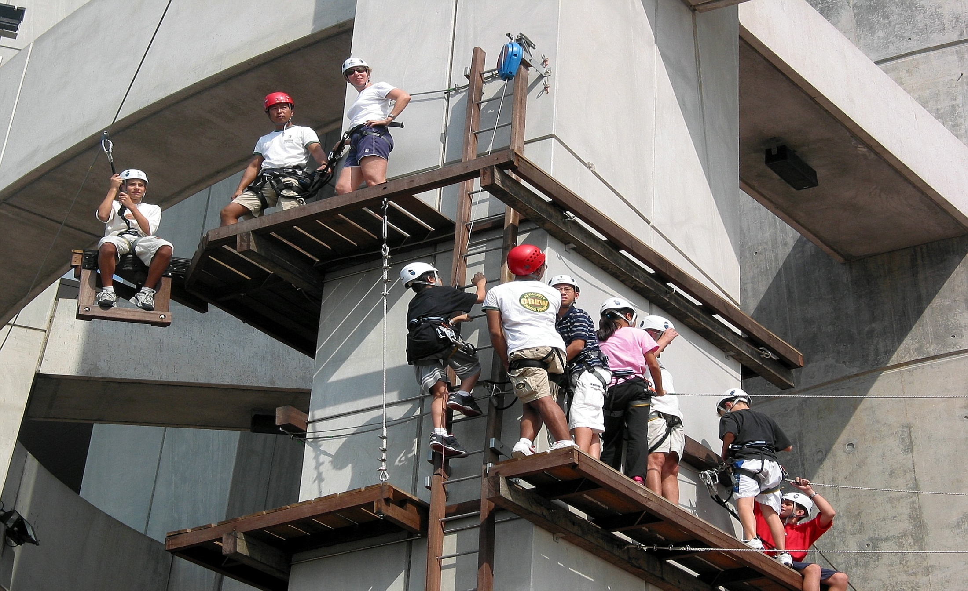
ГОРОДСКИЕ ПРИКЛЮЧЕНИЯ

Slide 31
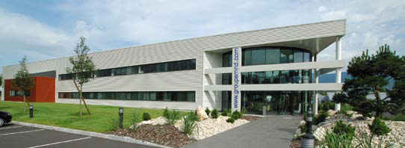
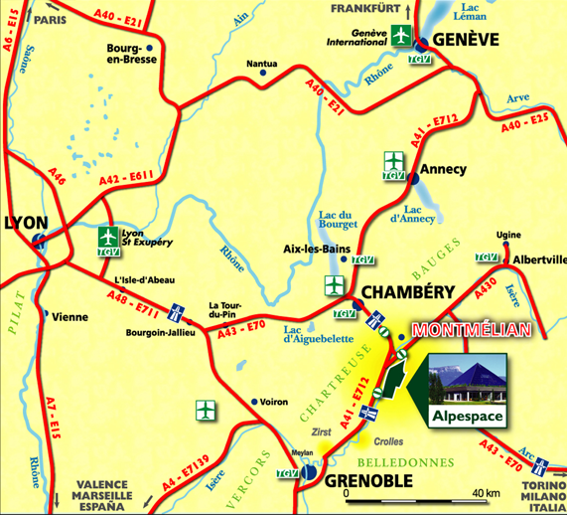
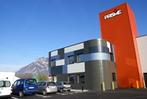
http://www.tech-fun.com

